Slide 1

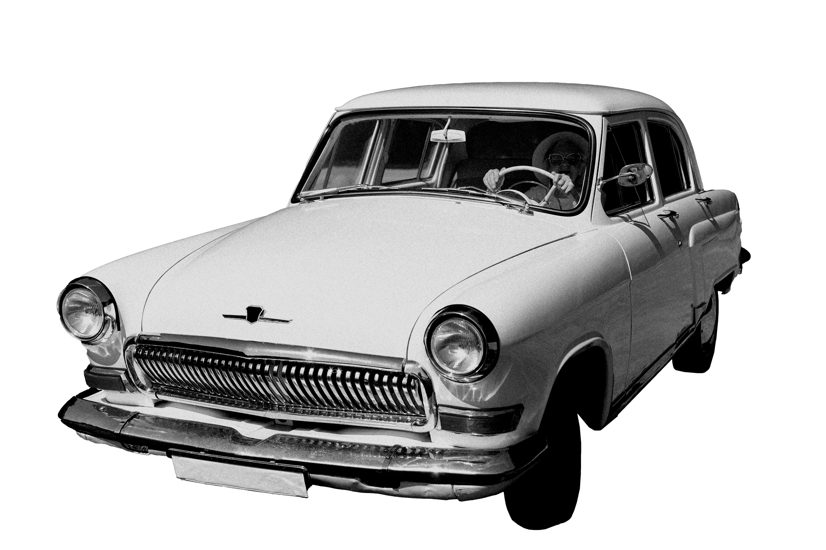
Presentation on Car Price Regression
Anish Maharjan
BIM 5th Semester

Slide 2

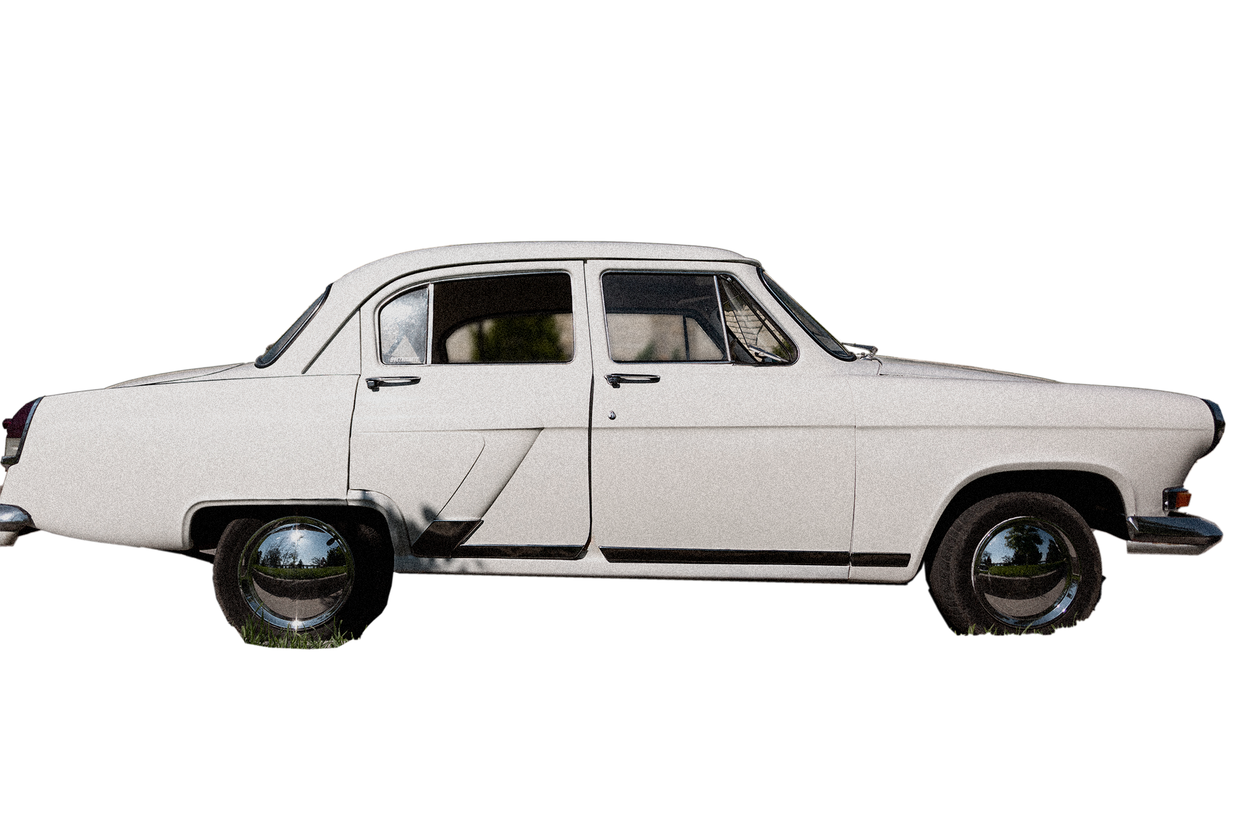
Introduction
Car price regression is the process of using data analysis and machine learning techniques to estimate or predict the price of a vehicle.
It involves predicting the price of a car based on various features and attributes associated with the vehicle.
This type of regression analysis can have several uses: Pricing strategy, Valuation, Market Research, Car Loan etc.

Slide 3

Steps
Import all the necessary library.
Load the data.
Perform EDA (Exploratory Data Analysis)
Feature Engineering (To know feature importance/which feature to select)
Split into independent and dependent features (x,y)
Split the data into Train and Test set(X_train, X_test, y_train, y_test)
Create the instance of the model.
Fit the data into algorithm.
Check the metrics.

Slide 4

EDA Performed in Data Analysis
Print top five records in the dataset. [data.head()]
Check the statistical information and distribution of data. [data.describe()]
Counting number of missing values in dataset. [data.isnull().sum()]

Slide 5
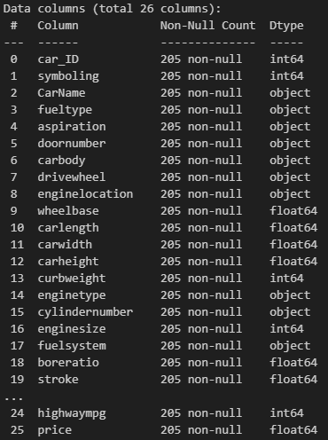
Dataset Information
10 columns of object datatype. (i.e. carName, fueltype, aspiration, doornumber, carbody etc).
8 columns of float datatype. (i.e. wheelbase, carlength, carwidth, carheight etc).
8 columns of integer datatype. (i.e. carID, symbolling highwaympg etc).

Slide 6

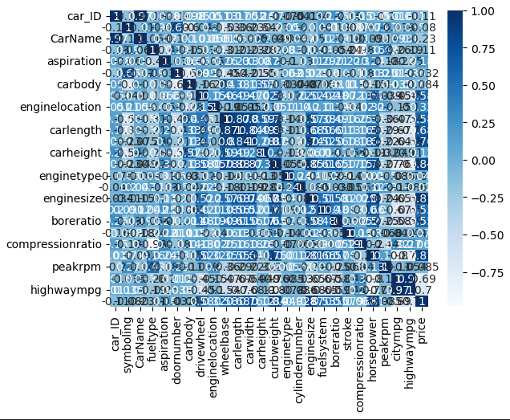
Visualization
A heatmap is used to visualize data relationships.
Dark Blue: Strong positive correlation (values closer to +1)
Light Blue: Weaker or no significant correlation (values closer to 0)

Slide 7

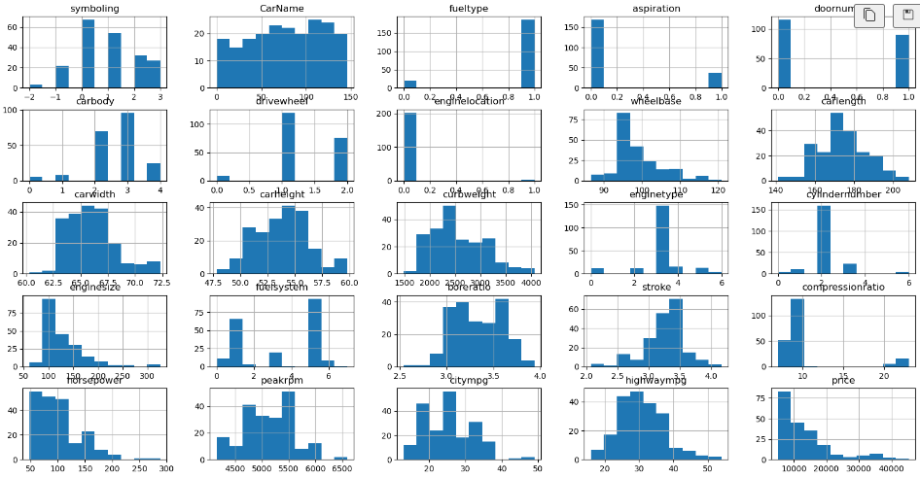
Histogram
It shows the frequency of data within each bin or interval.
It can be used to transform continuous data into categorical data by dividing it into bins.
A graph that shows how a dataset is distributed.

Slide 8

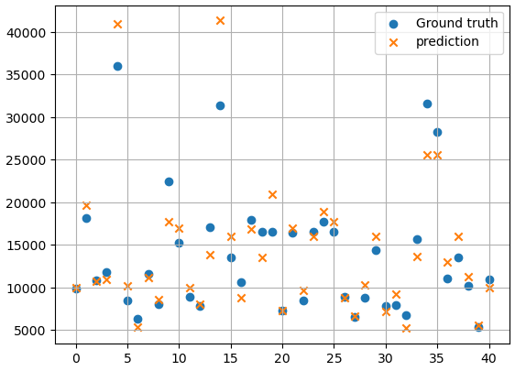
Scatterplot
It is used to display the relationship between two continuous variables.
It is used to display individual data points as points on a two-dimensional graph.

Slide 9

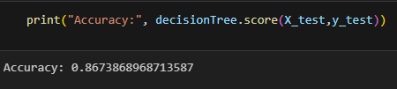
Accuracy
It is used for evaluating the performance of regression or classification models.
It measures the proportion of correctly predicted instances or observations out of the total instances in a dataset.

Slide 10
Video Demo

Slide 11
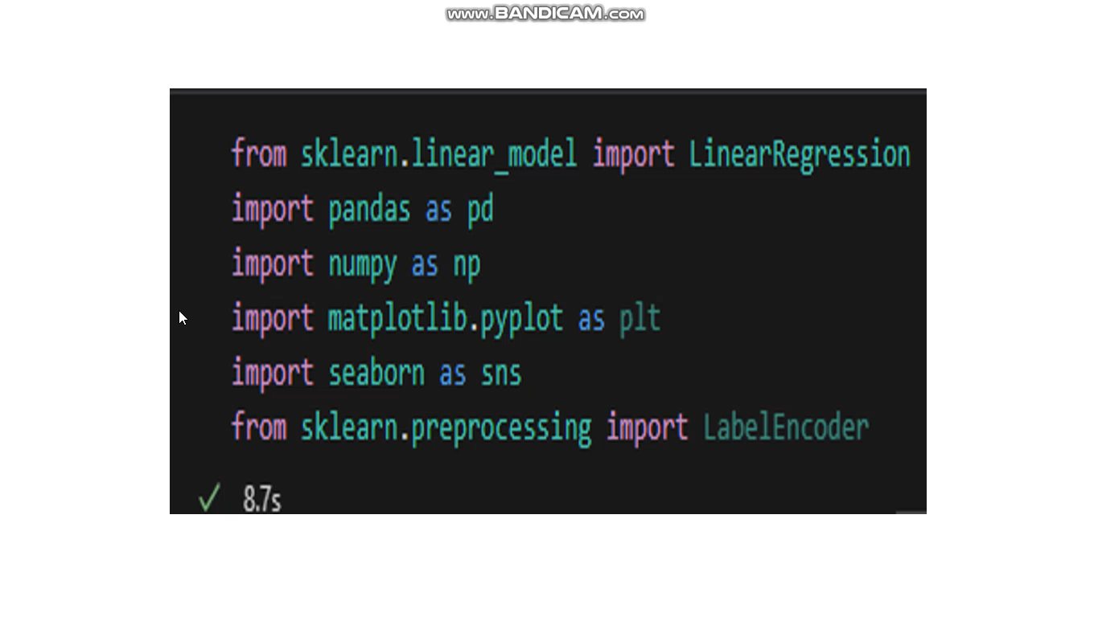

Slide 12
Conclusion
In conclusion, Python projects are versatile and valuable tools for tackling real-world challenges and driving innovation in technology and beyond. Through this project, we have learned how to use Python and its libraries.

Slide 13
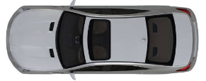
Thank you!

